Slide 1
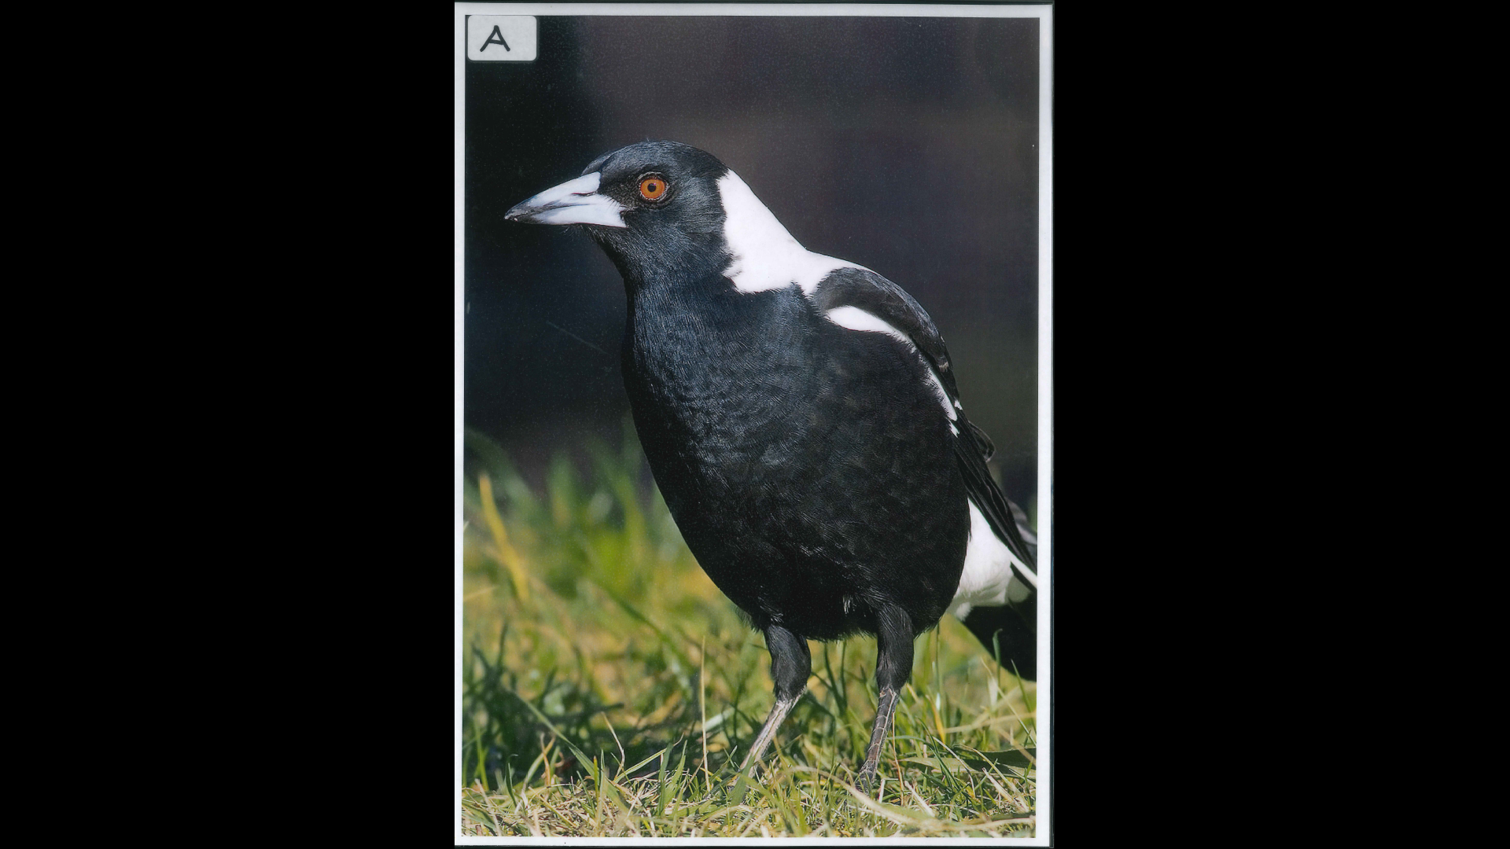

Slide 2
Kingdom: Animalia
Phylum/Division: Chordata
Class: Aves
Common Name: Magpie

Slide 3
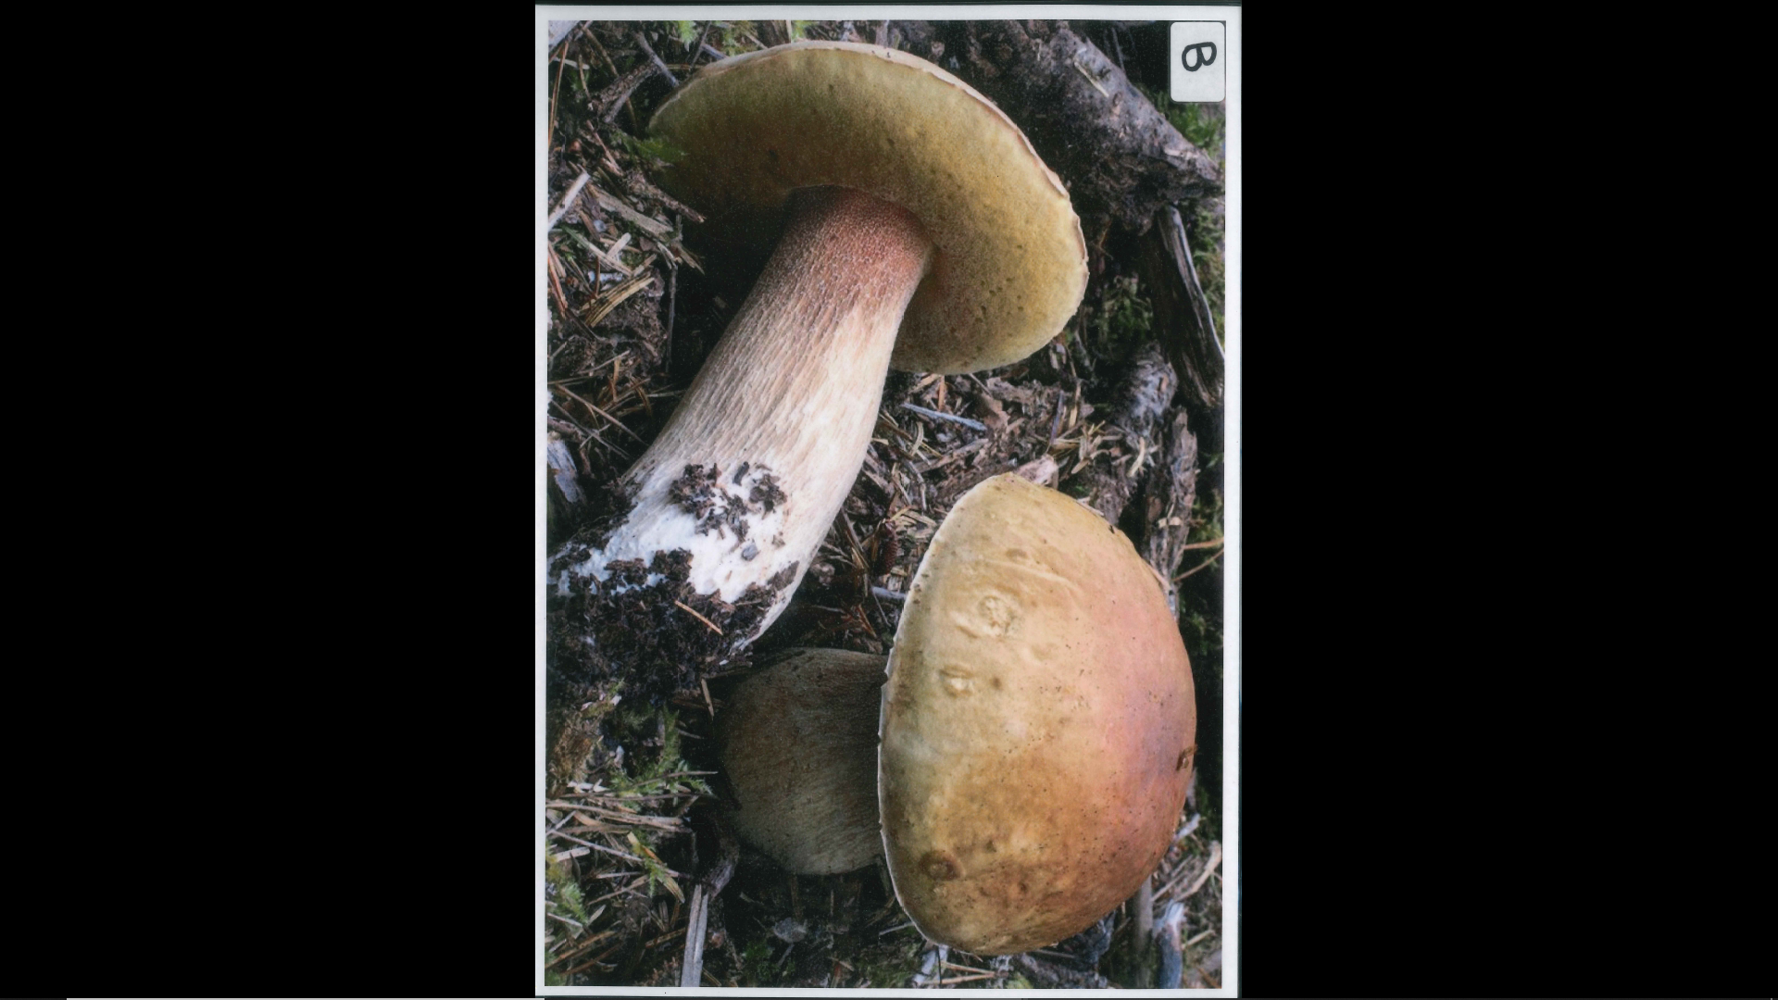
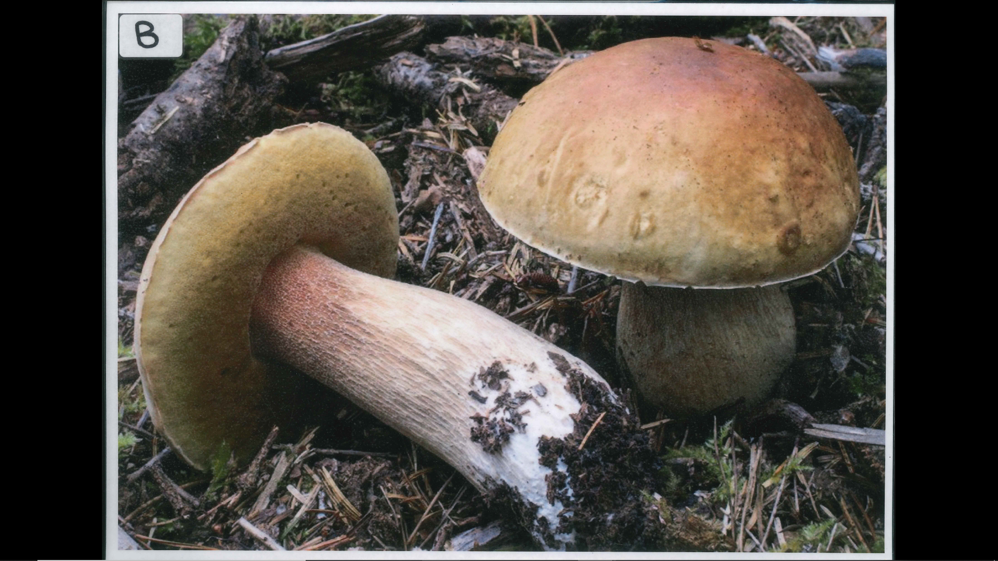

Slide 4
Kingdom: Fungi
Phylum/Division: Basidiomycota
Class: Agaricomycetes
Common Name: Edible mushroom

Slide 5
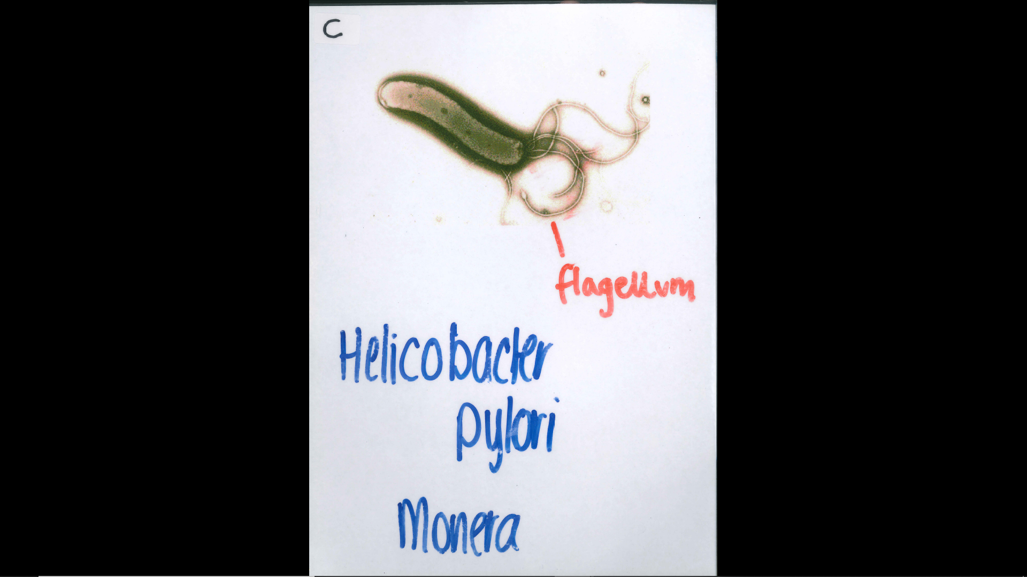

Slide 6
Kingdom: Monera
Phylum/Division: Proteobacteria
Class: Epsilonproteo-bacteria
Common Name: Helicobacter pylori

Slide 7


Slide 8
Kingdom: Animalia
Phylum/Division: Chordata
Class: Mammalia
Common Name: Dog

Slide 9


Slide 10
Kingdom: Plantae
Phylum/Division: Tracheophyta
Class: Angiosperms
Common Name: Jacaranda

Slide 11
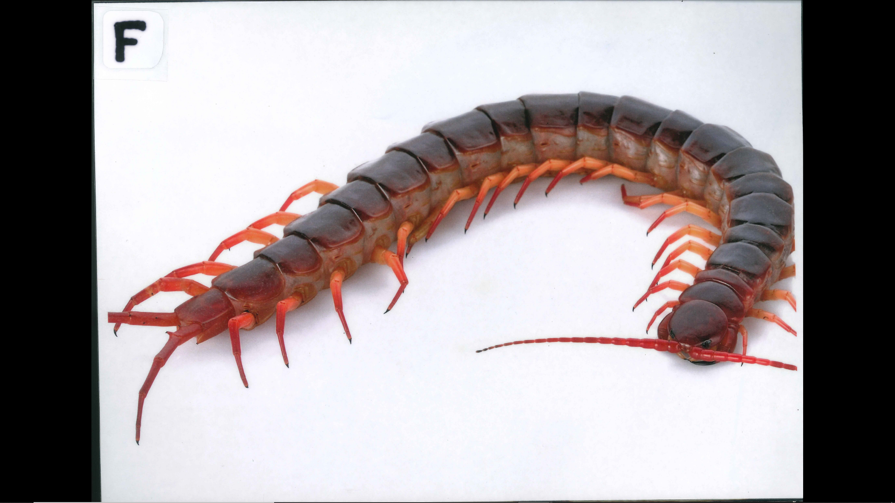

Slide 12
Kingdom: Animalia
Phylum/Division: Arthropoda
Class: Chilopoda
Common Name: Centipede

Slide 13
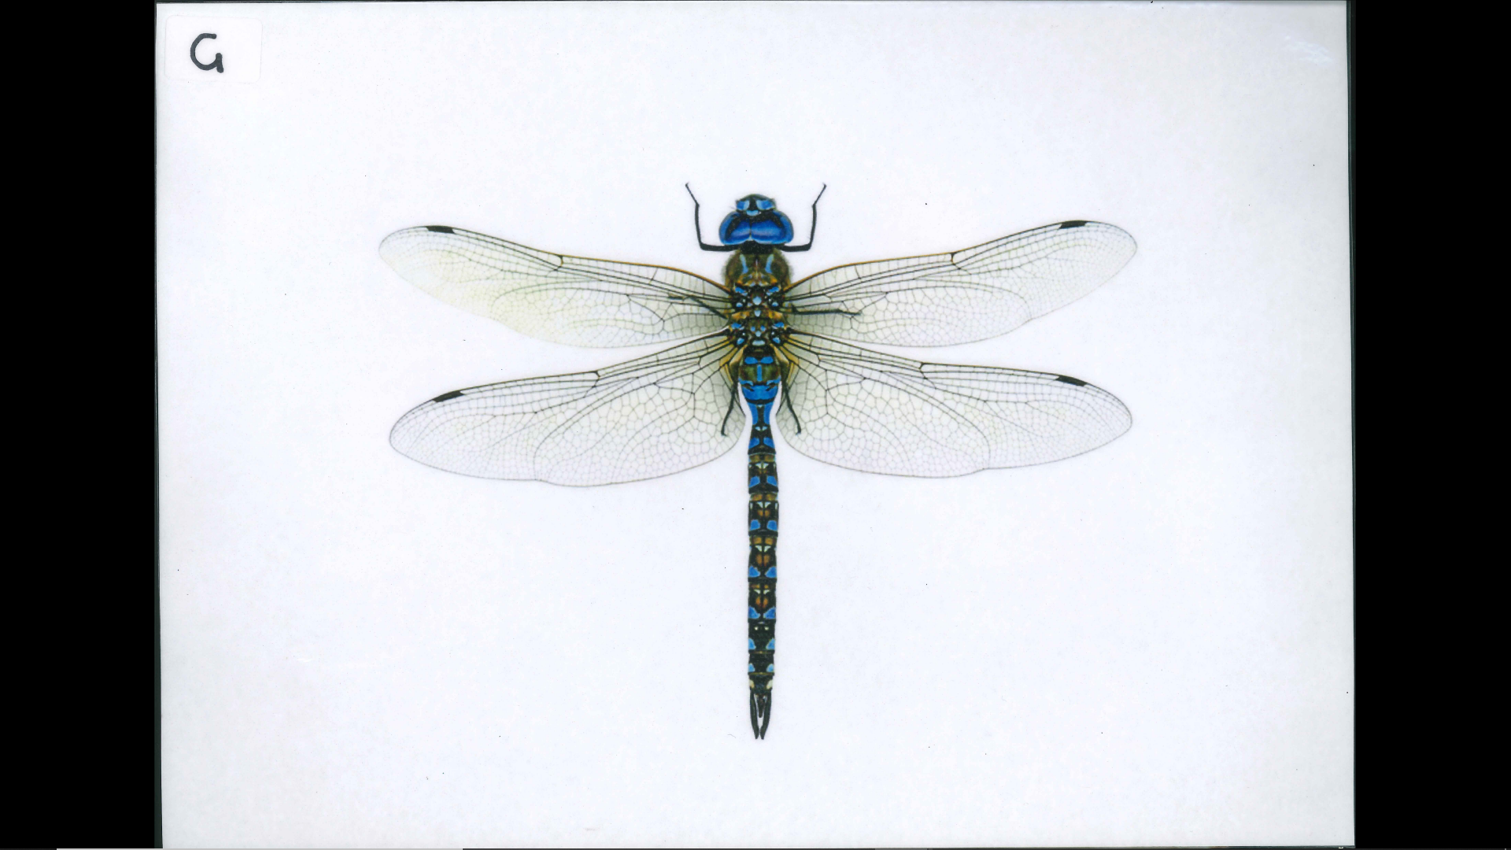

Slide 14
Kingdom: Animalia
Phylum/Division: Arthropoda
Class: Insecta
Common Name: Dragonfly

Slide 15
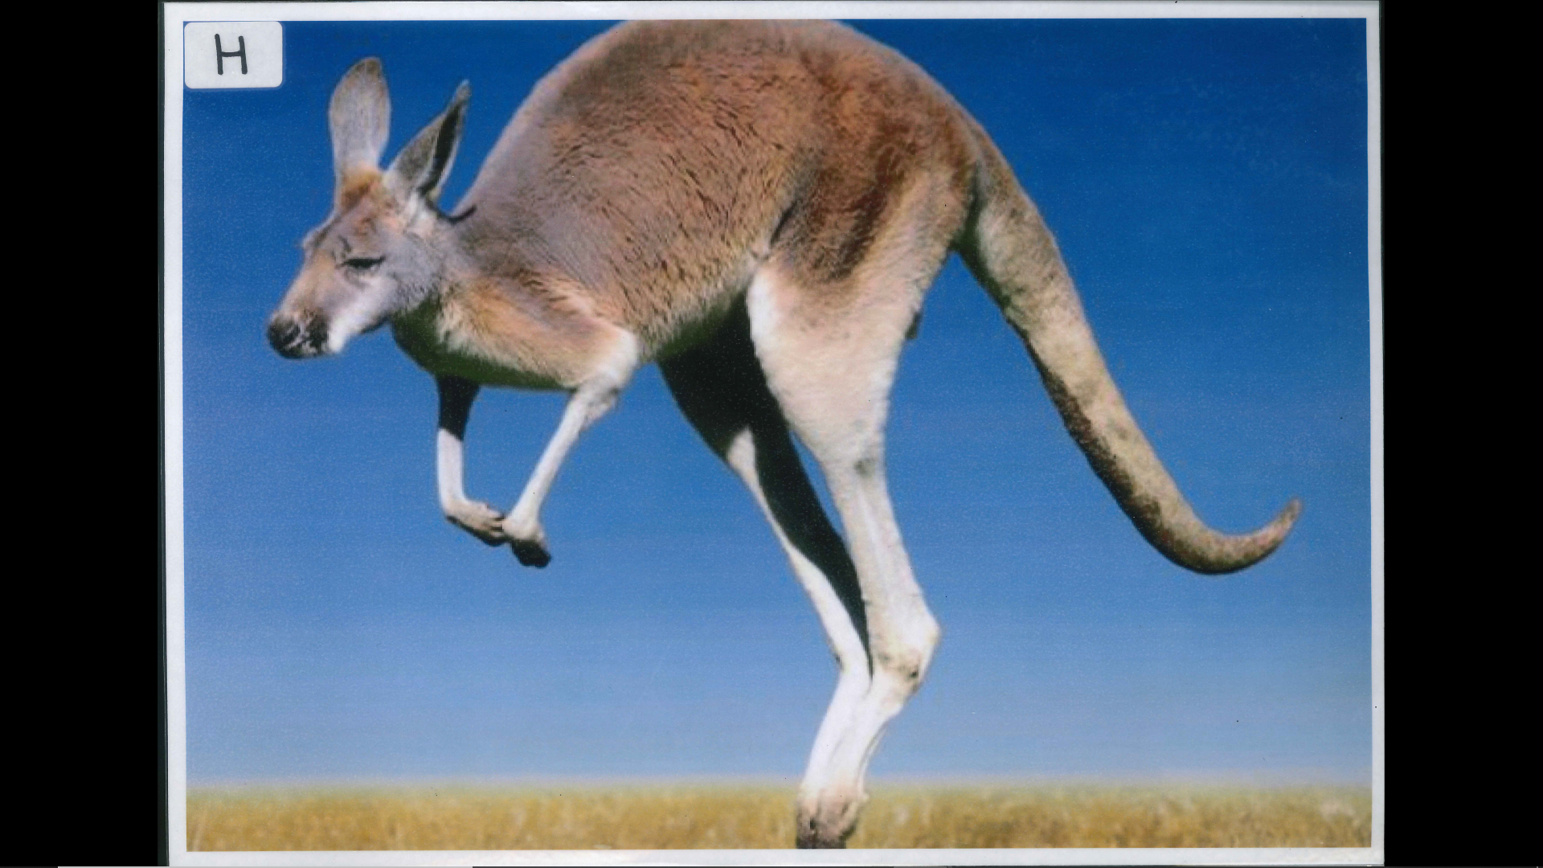

Slide 16
Kingdom: Animalia
Phylum/Division: Chordata
Class: Mammalia (Marsupials)
Common Name: Kangaroo

Slide 17


Slide 18
Kingdom: Plantae
Phylum/Division: Tracheophyta
Class: Angiosperms
Common Name: Water Lily

Slide 19
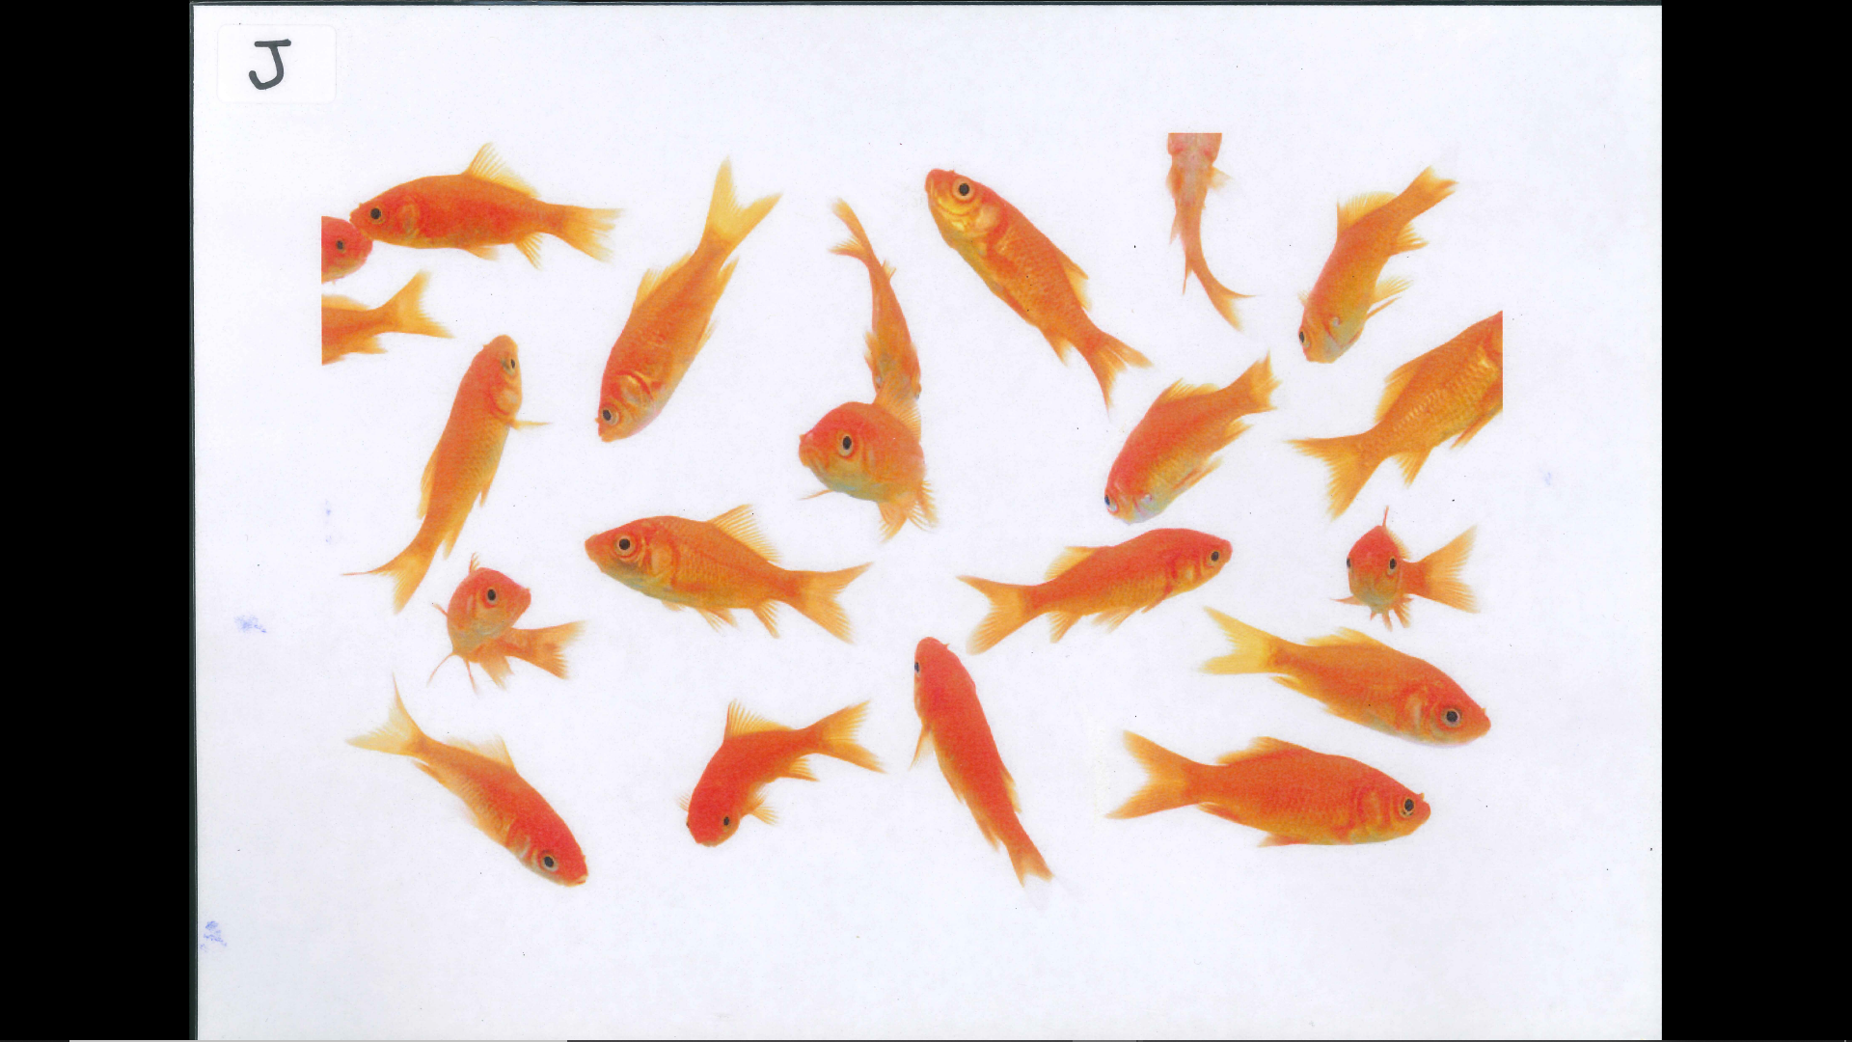

Slide 20
Kingdom: Animalia
Phylum/Division: Chordata
Class: Pisces
Common Name: Goldfish

Slide 21
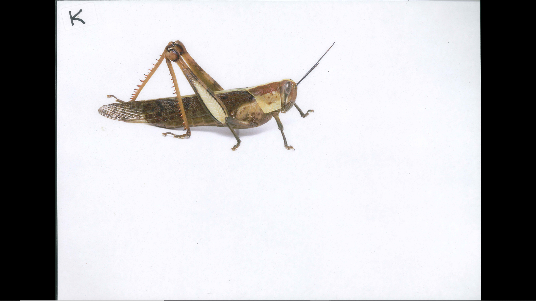

Slide 22
Kingdom: Animalia
Phylum/Division: Arthropoda
Class: Insecta
Common Name: Grasshopper

Slide 23
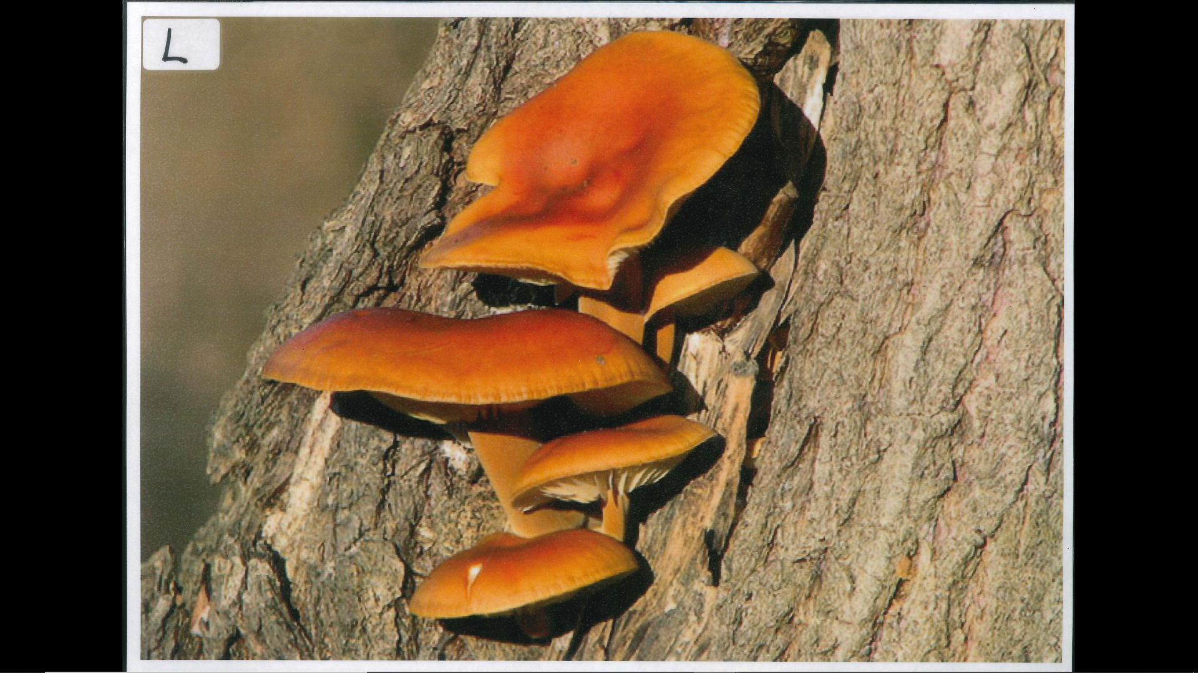

Slide 24
Kingdom: Fungi
Phylum/Division: Basidiomycota
Class: Agaricomycetes
Common Name: Tree Fungus

Slide 25
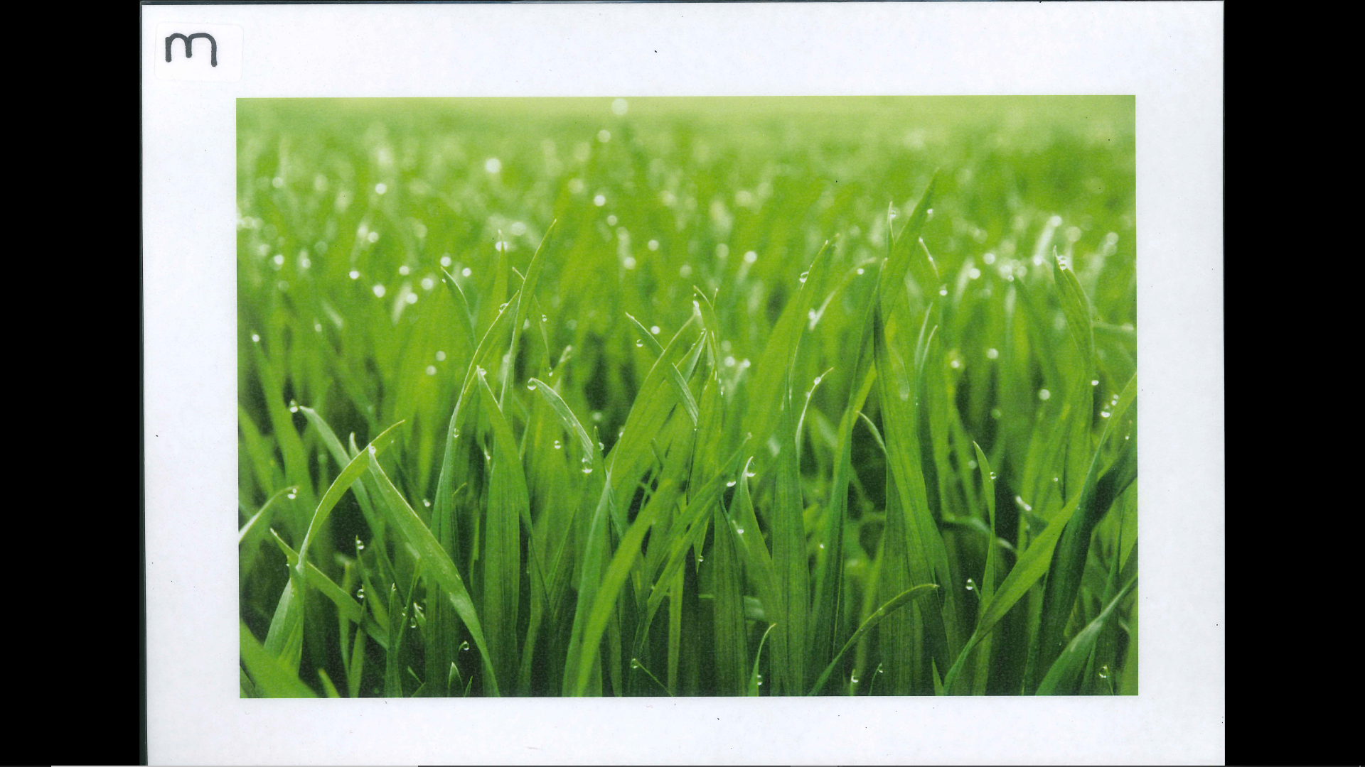

Slide 26
Kingdom: Plantae
Phylum/Division: Tracheophyta
Class: Angiosperms
Common Name: Grass

Slide 27
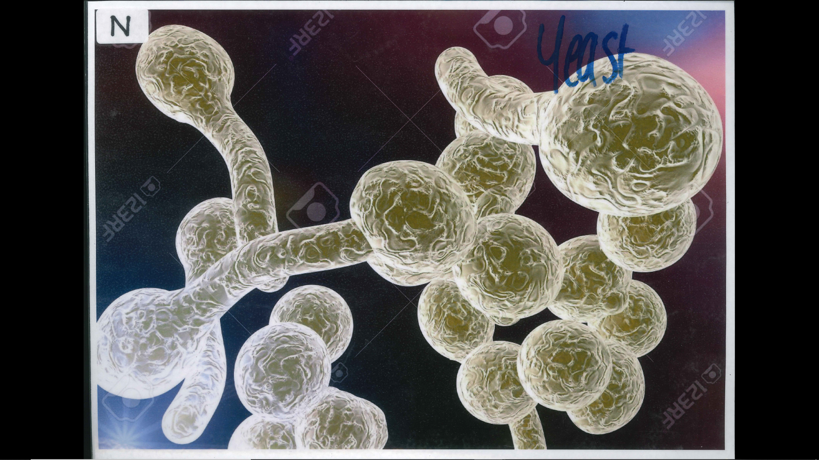

Slide 28
Kingdom: Fungi
Phylum/Division: Ascomycota
Class: Saccharomycetes
Common Name: Yeast

Slide 29
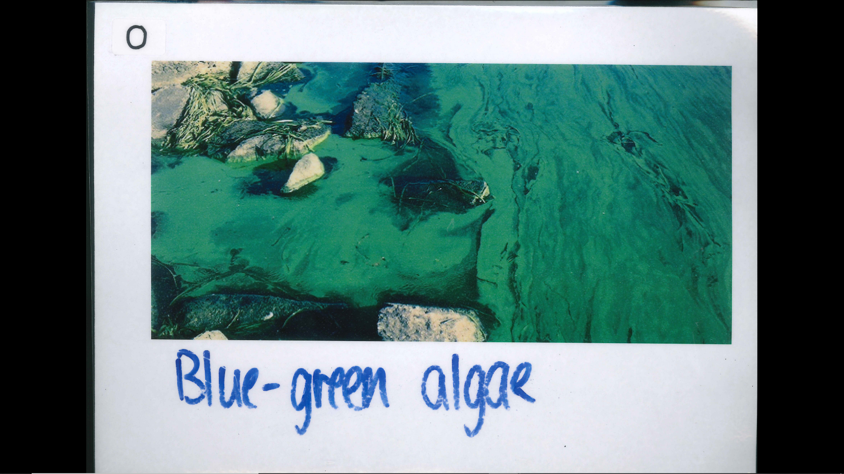

Slide 30
Kingdom: Protista
Phylum/Division: Cyanobacteria
Class: Cyanophyceae
Common Name: Blue-green Algae

Slide 31
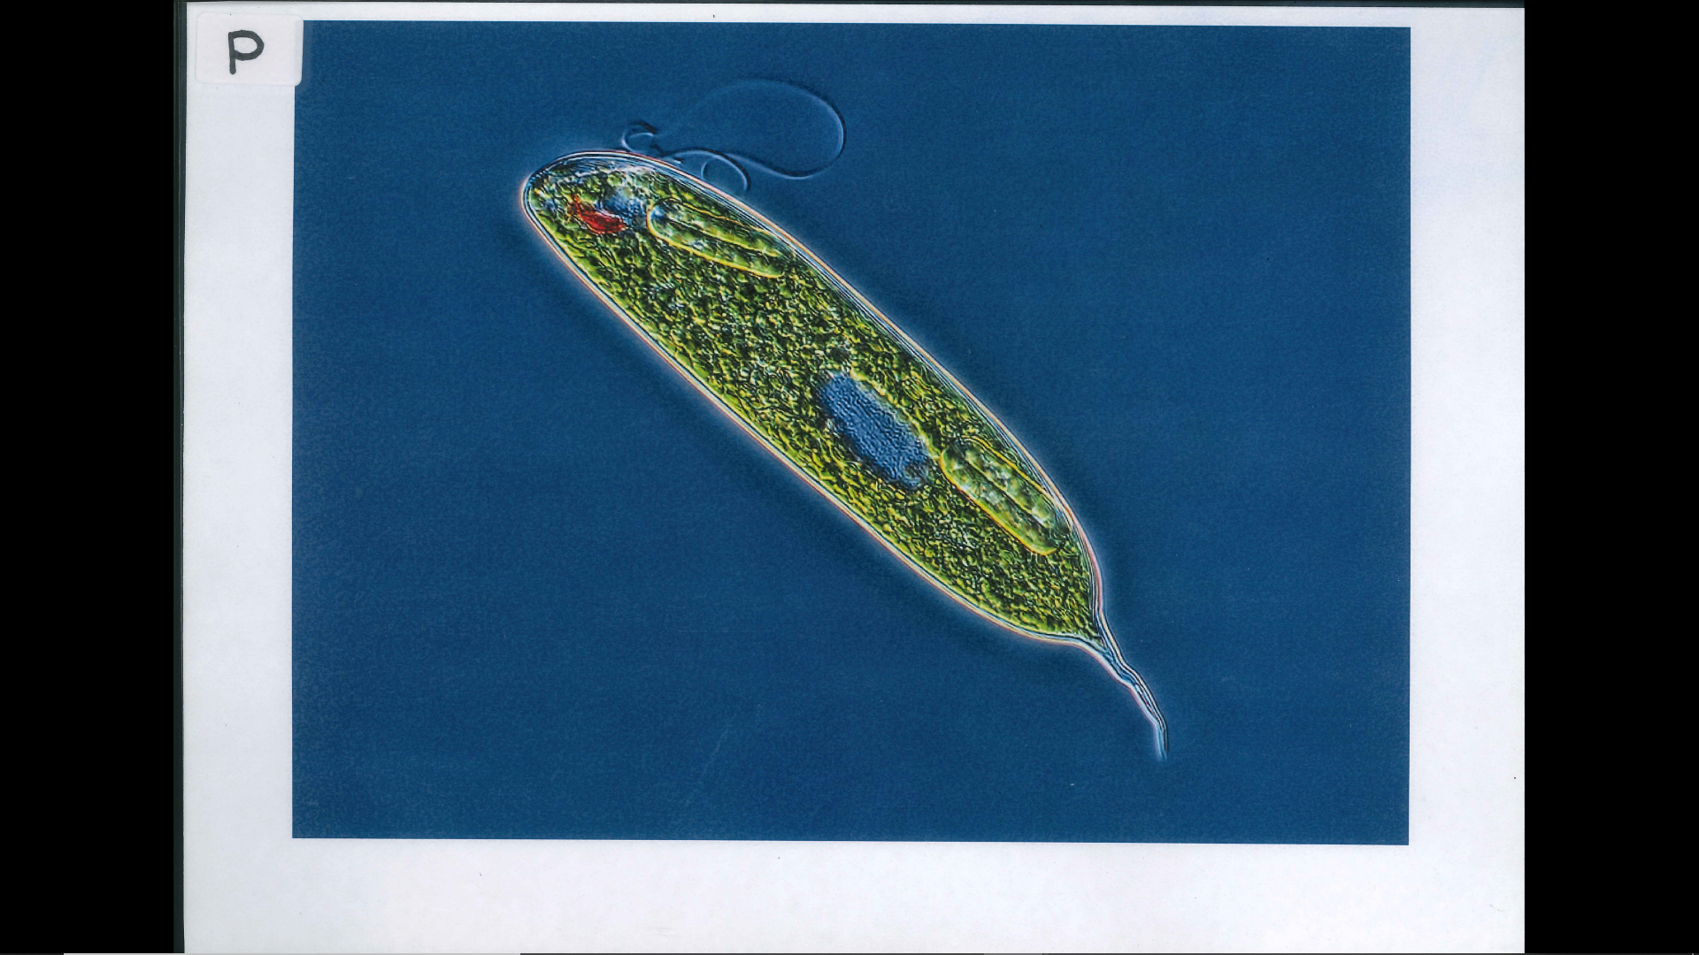

Slide 32
Kingdom: Protista
Phylum/Division: Euglenozoa
Class: Euglenoida
Common Name: Euglena Algae

Slide 33
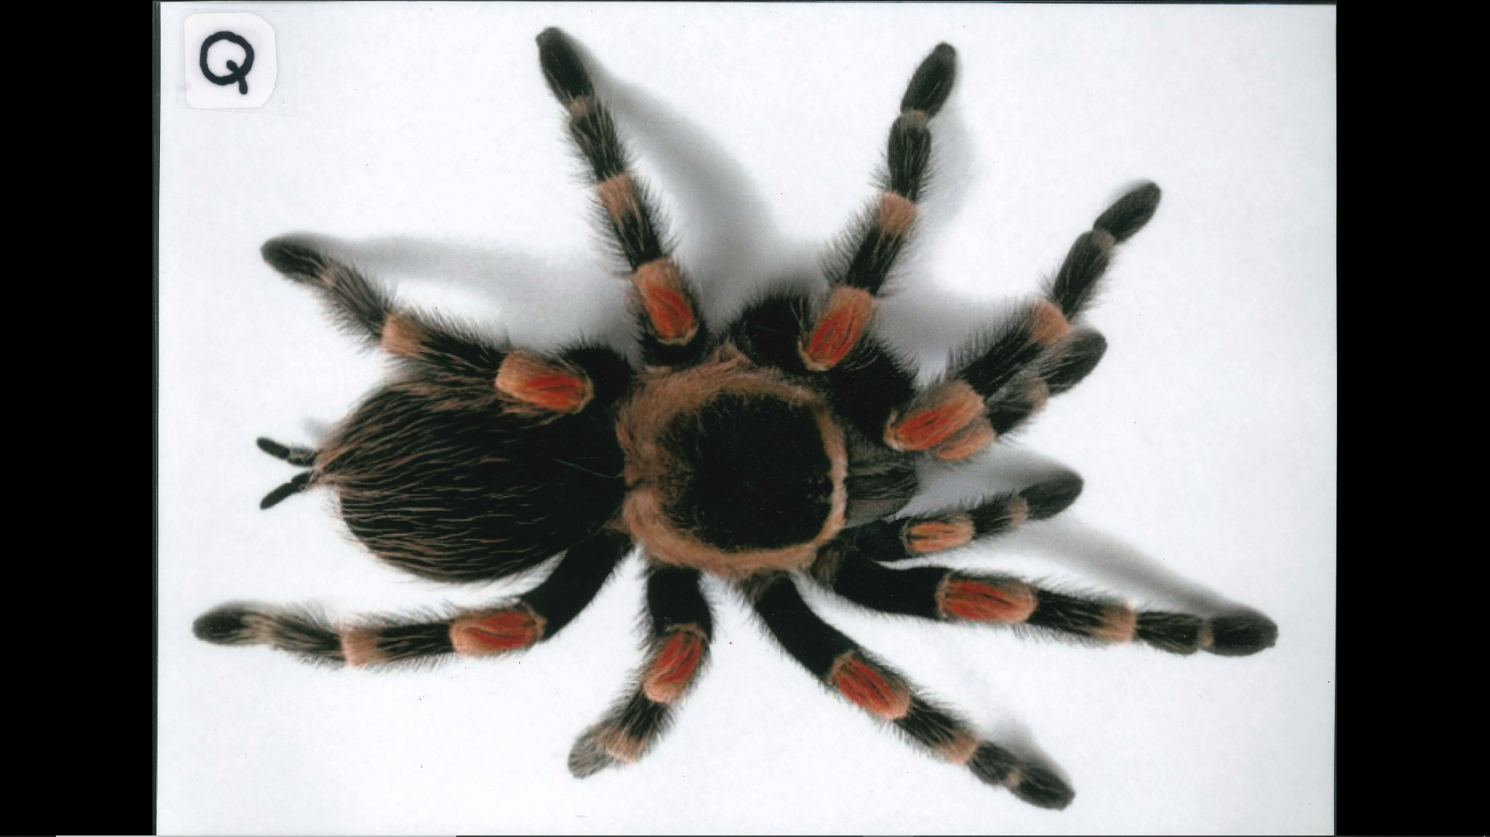

Slide 34
Kingdom: Animalia
Phylum/Division: Arthropoda
Class: Arachnida
Common Name: Tarantula

Slide 35
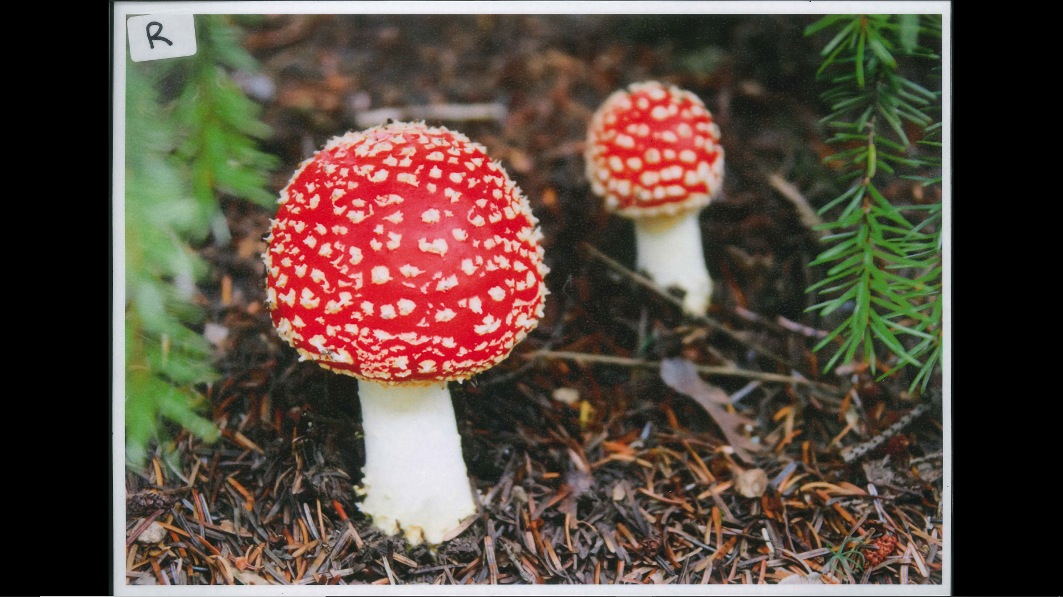

Slide 36
Kingdom: Fungi
Phylum/Division: Basidiomycota
Class: Agaricomycetes
Common Name: Toadstool

Slide 37
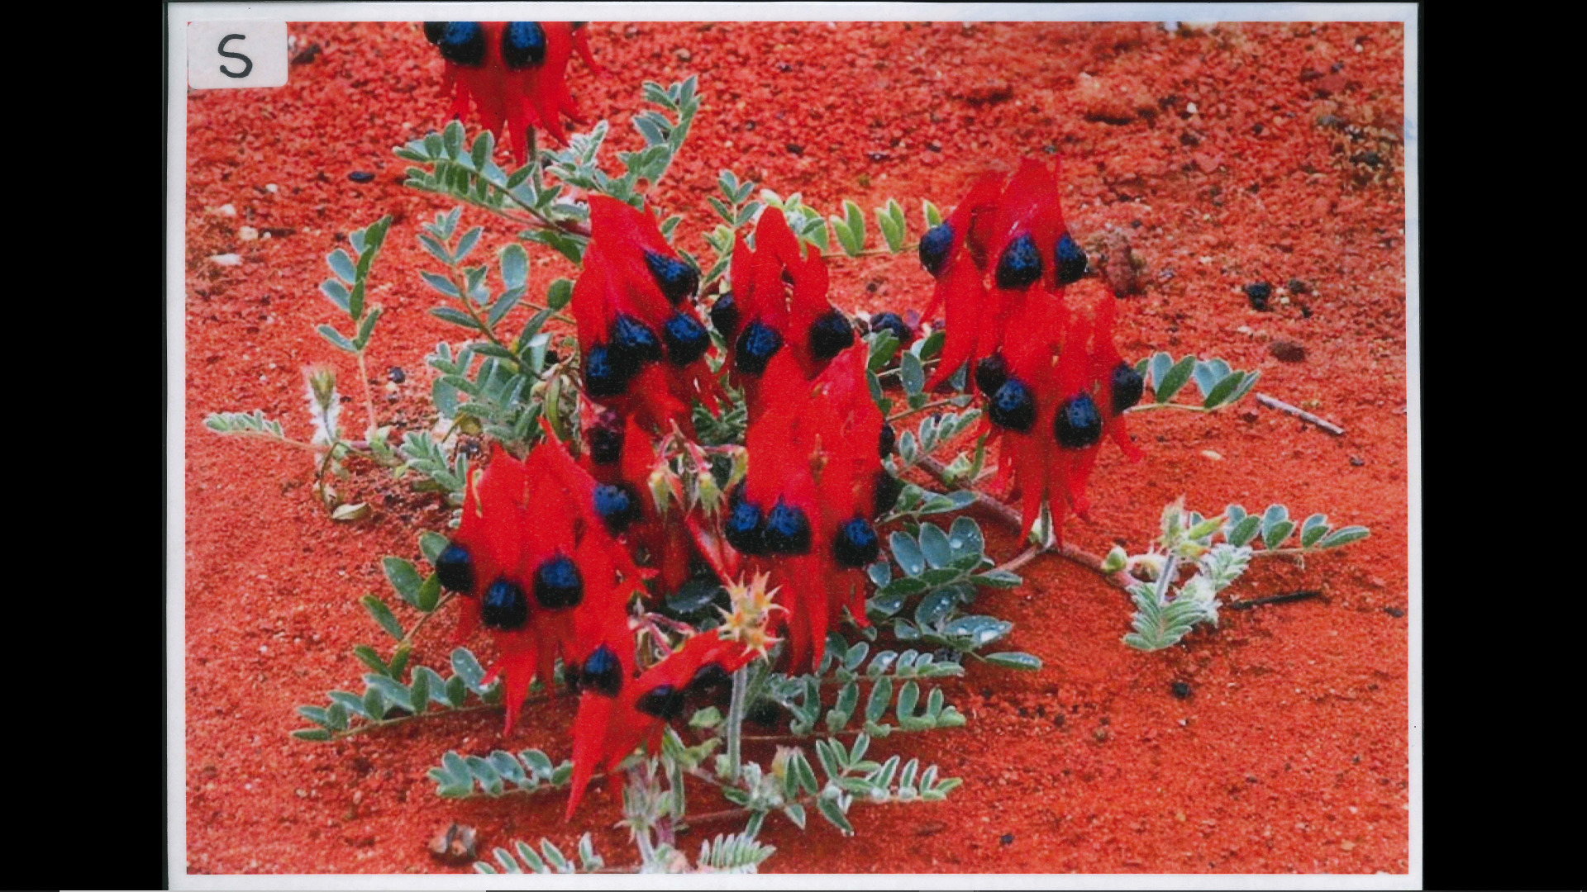

Slide 38
Kingdom: Plantae
Phylum/Division: Tracheophyta
Class: Angiosperms
Common Name: Sturt’s Desert Pea

Slide 39
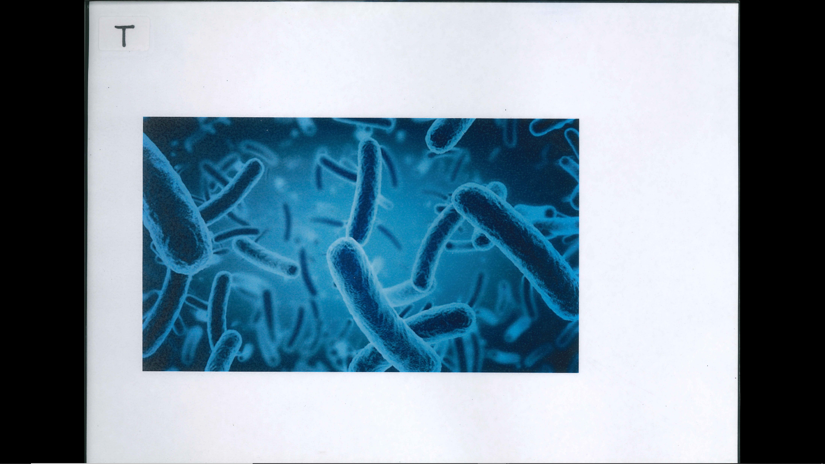

Slide 40
Kingdom: Monera
Phylum/Division: Proteobacteria
Class: Gammaproteo-bacteria
Common Name: E.coli

Slide 41


Slide 42
Kingdom: Plantae
Phylum/Division: Tracheophyta
Class: Angiosperms
Common Name: Rose Bush

Slide 43


Slide 44
Kingdom: Animalia
Phylum/Division: Chordata
Class: Mammalia
Common Name: Cat

Slide 45


Slide 46
Kingdom: Animalia
Phylum/Division: Chordata
Class: Mammalia
Common Name: People

Slide 47
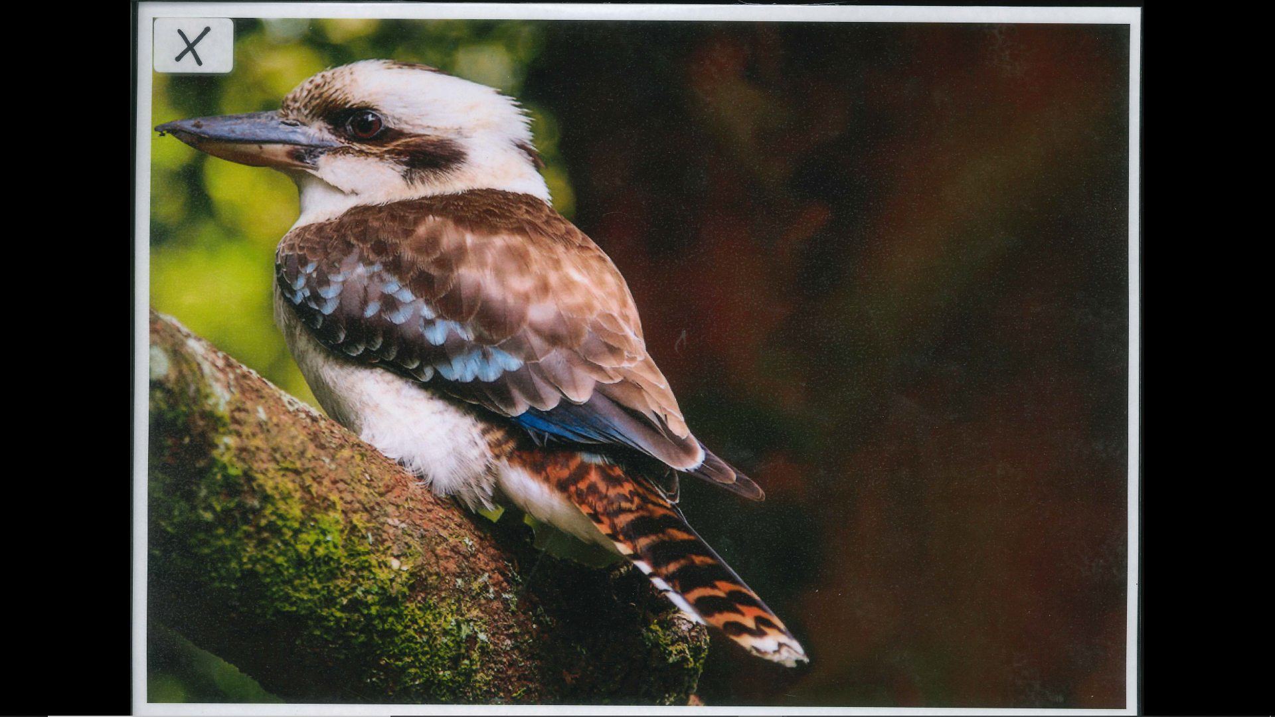

Slide 48
Kingdom: Animalia
Phylum/Division: Chordata
Class: Aves
Common Name: Kookaburra

Slide 49
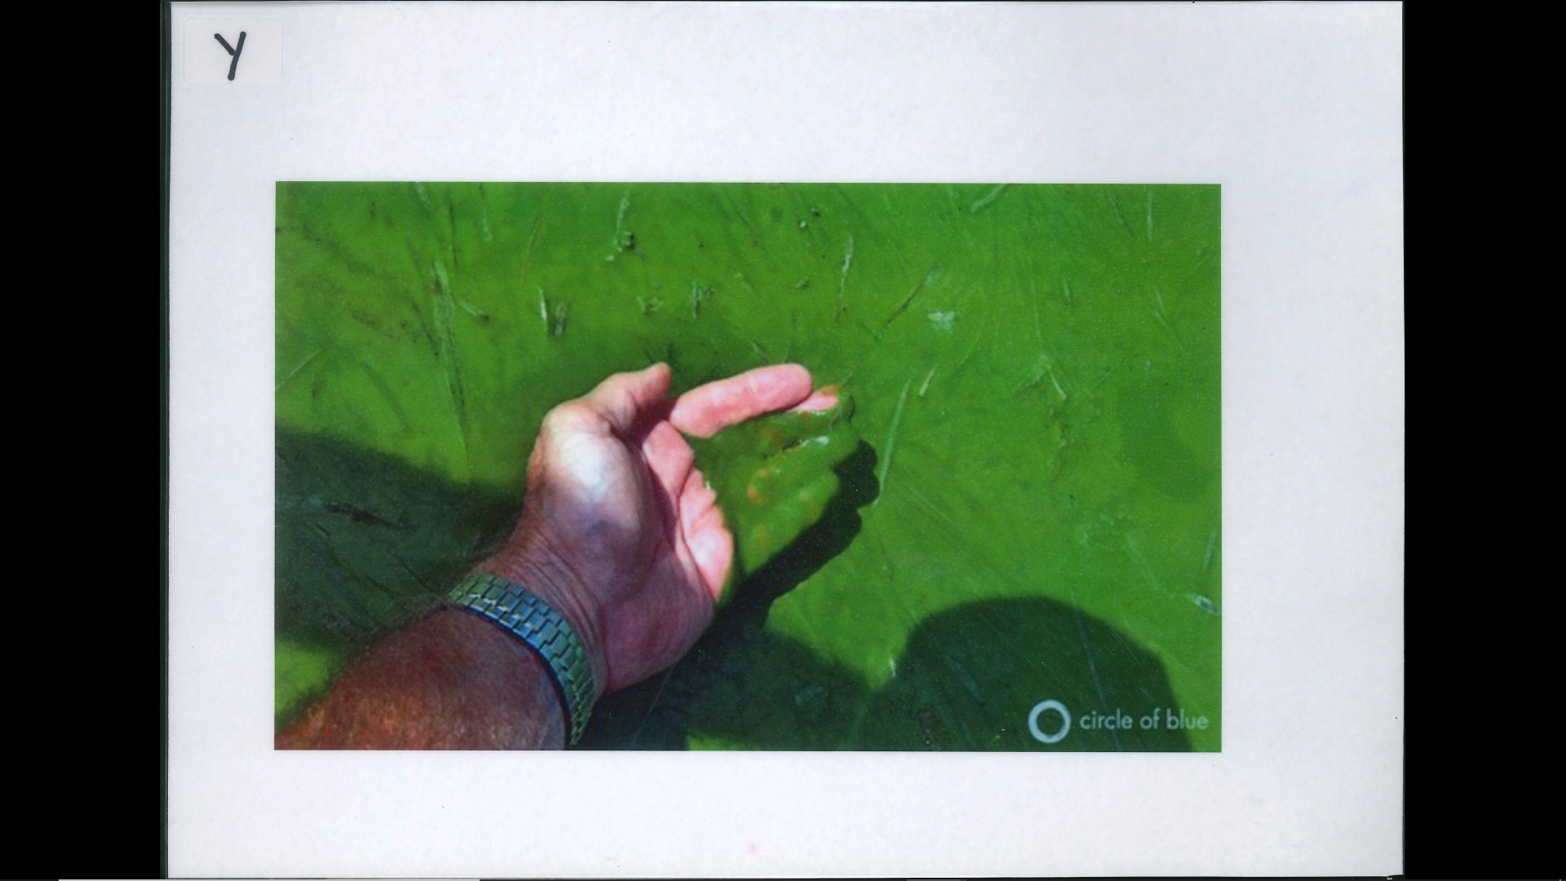

Slide 50
Kingdom: Plantae
Phylum/Division: Chlorophyta
Class: Chlorophyceae
Common Name: Green Algae

Slide 51
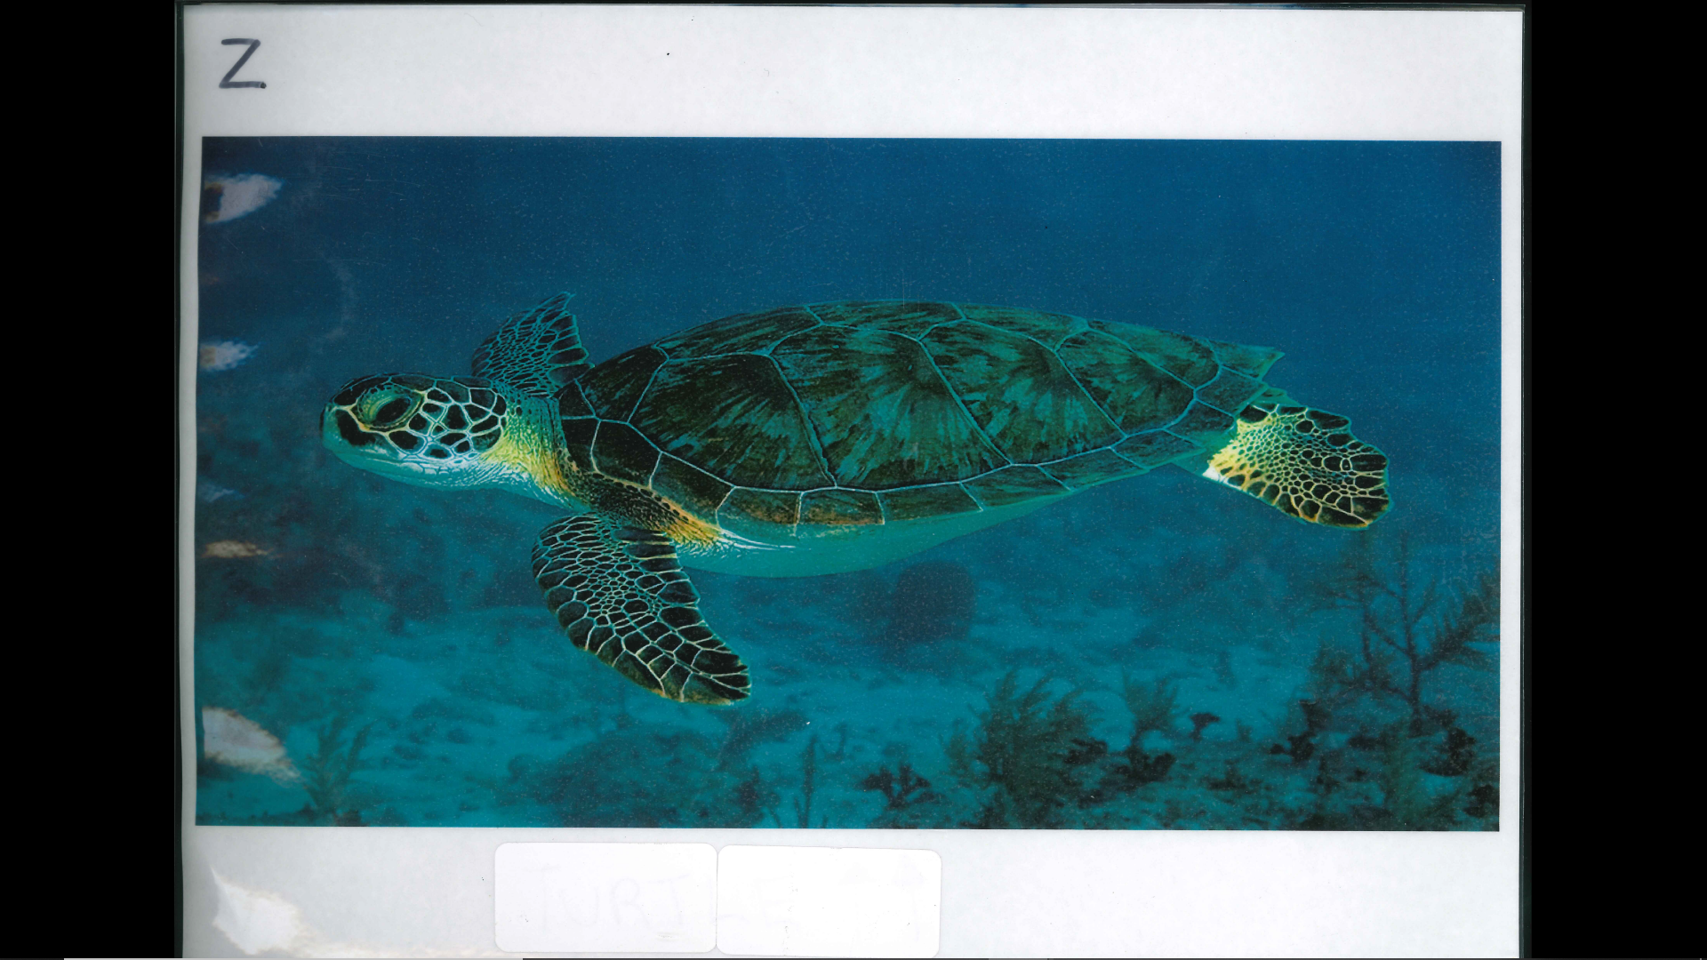

Slide 52
Kingdom: Animalia
Phylum/Division: Chordata
Class: Reptilia
Common Name: Sea Turtle

Slide 53
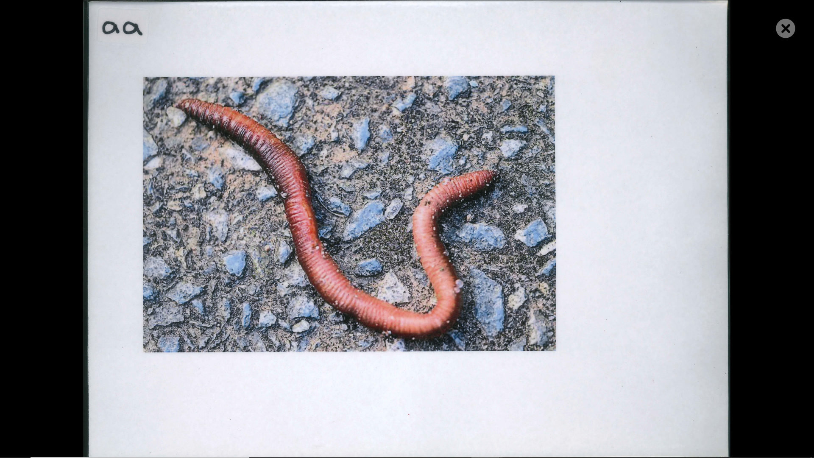

Slide 54
Kingdom: Animalia
Phylum/Division: Annelida
Class: Clitellata
Common Name: Earthworm

Slide 55
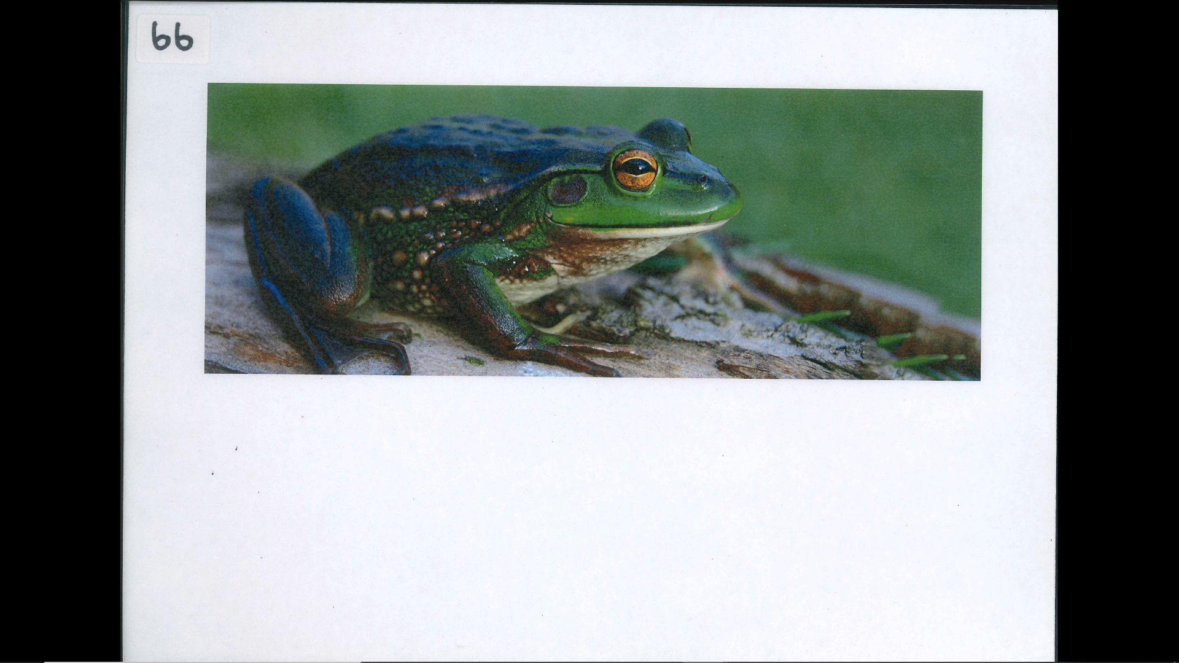

Slide 56
Kingdom: Animalia
Phylum/Division: Chordata
Class: Amphibia
Common Name: Frog

